Slide 1
High-Intensity Scripting
Revisiting Speed Optimizations with PowerShell 7
Josh King

Slide 2


Who am i?
Josh King
ToastIT.dev
@WindosNZ
Microsoft MVP
TechOps Sysadmin @ Tribe

Slide 3

Revisit?
What’s changed?
PowerShell 7 = Magic?
https://toast.click/PS7-GA
https://toast.click/WhipYourScripts

Slide 4
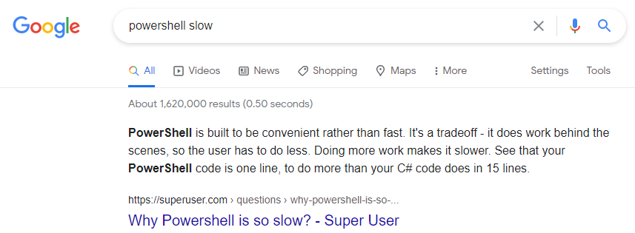
Why worry About Speed in PowerShell?
Bad perception
Common complaint

Slide 5
Testing Methodology
If you’re looking for improvements, measure it!
Make one change at a time
Test it more than once
Don’t slow things down by measuring it…

Slide 6
Code time!
(Enough with the words)

